Slide 1

Unit 2 What’s that?
Module 7

Slide 2


Magic bag
猜猜魔法袋里有什么？

Slide 3

Pen and pencil.
Pencil and pen.
Pen and pencil.
Say it again!

Slide 4
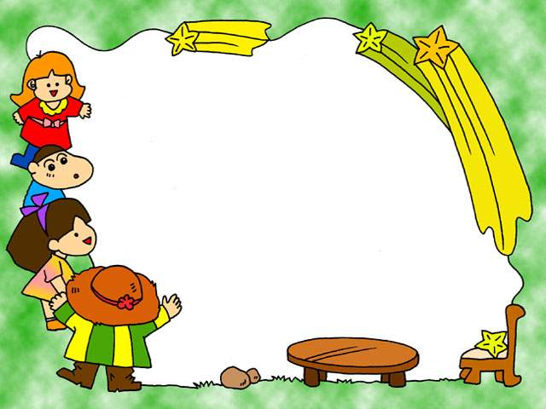
What’s this?
这是什么?
PPT模板：www.1ppt.com/moban/ PPT素材：www.1ppt.com/sucai/
PPT背景：www.1ppt.com/beijing/ PPT图表：www.1ppt.com/tubiao/
PPT下载：www.1ppt.com/xiazai/ PPT教程： www.1ppt.com/powerpoint/
资料下载：www.1ppt.com/ziliao/ 范文下载：www.1ppt.com/fanwen/
试卷下载：www.1ppt.com/shiti/ 教案下载：www.1ppt.com/jiaoan/
PPT论坛：www.1ppt.cn PPT课件：www.1ppt.com/kejian/
语文课件：www.1ppt.com/kejian/yuwen/ 数学课件：www.1ppt.com/kejian/shuxue/
英语课件：www.1ppt.com/kejian/yingyu/ 美术课件：www.1ppt.com/kejian/meishu/
科学课件：www.1ppt.com/kejian/kexue/ 物理课件：www.1ppt.com/kejian/wuli/
化学课件：www.1ppt.com/kejian/huaxue/ 生物课件：www.1ppt.com/kejian/shengwu/
地理课件：www.1ppt.com/kejian/dili/ 历史课件：www.1ppt.com/kejian/lishi/
What’s that?
那是什么？

Slide 5


问距离比较近的
What’s this?
It’s a …
What’s that?
问距离比较远的

Slide 6
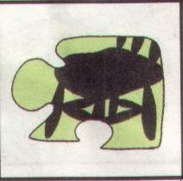

It’s a chair.
Notes:
PPT模板：www.1ppt.com/moban/ PPT素材：www.1ppt.com/sucai/
PPT背景：www.1ppt.com/beijing/ PPT图表：www.1ppt.com/tubiao/
PPT下载：www.1ppt.com/xiazai/ PPT教程： www.1ppt.com/powerpoint/
资料下载：www.1ppt.com/ziliao/ 范文下载：www.1ppt.com/fanwen/
试卷下载：www.1ppt.com/shiti/ 教案下载：www.1ppt.com/jiaoan/
PPT论坛：www.1ppt.cn PPT课件：www.1ppt.com/kejian/
语文课件：www.1ppt.com/kejian/yuwen/ 数学课件：www.1ppt.com/kejian/shuxue/
英语课件：www.1ppt.com/kejian/yingyu/ 美术课件：www.1ppt.com/kejian/meishu/
科学课件：www.1ppt.com/kejian/kexue/ 物理课件：www.1ppt.com/kejian/wuli/
化学课件：www.1ppt.com/kejian/huaxue/ 生物课件：www.1ppt.com/kejian/shengwu/
地理课件：www.1ppt.com/kejian/dili/ 历史课件：www.1ppt.com/kejian/lishi/

Slide 7

It’s a desk.

Slide 8
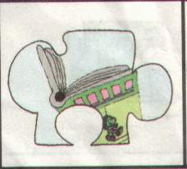
It’s a book.

Slide 9

It’s a pencil.

Slide 10

It’s a pen.

Slide 11
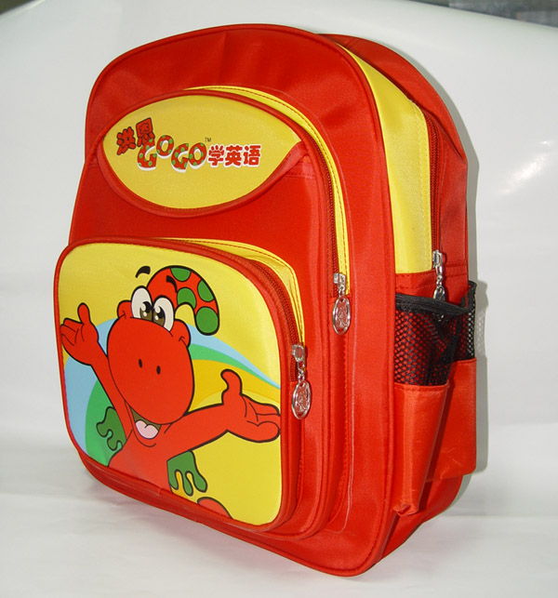
a schoolbag

Slide 12

a ball

Slide 13
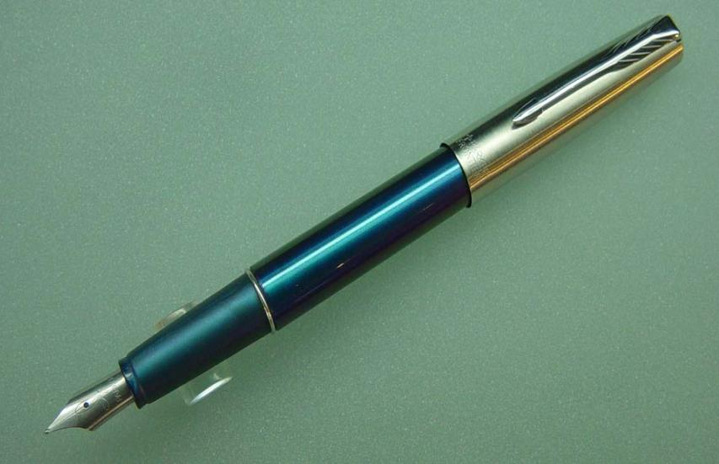
a pen

Slide 14
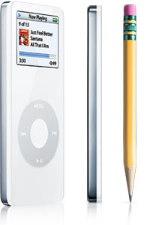
a pencil

Slide 15

a book

Slide 16
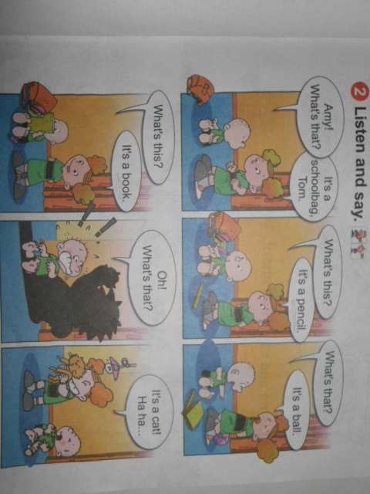

Slide 17




pencil
schoolbag
pen
book

Slide 18
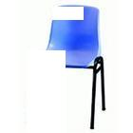


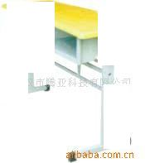



Slide 19





Slide 20


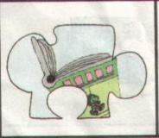
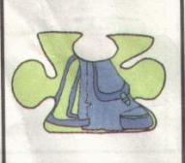


chair
desk
book
schoolbag
pencil
pen

